Slide 1
Awareness Over Distributed Version Control Systems
Cristiano Machado Cesário
Advisor: Prof. D.Sc. Leonardo Gresta Paulino Murta
DyeVC está disponível em http://gems.ic.uff.br/dyevc

Slide 2
Índice
Introdução
Trabalhos relacionados
Objetivo
DyeVC: visão geral
Avaliação
Conclusão

Slide 3
1. Introdução
Repositórios Centralizados x Distribuídos
Área de Trabalho
Repositório
Repositório
clone / pull
check-out / update
check-in / commit
push
Repositório
check-out / update
Área de Trabalho
commit
Área de Trabalho
Repositório Centralizado
Repositório Distribuído
Extraído de MURTA 2012

Slide 4
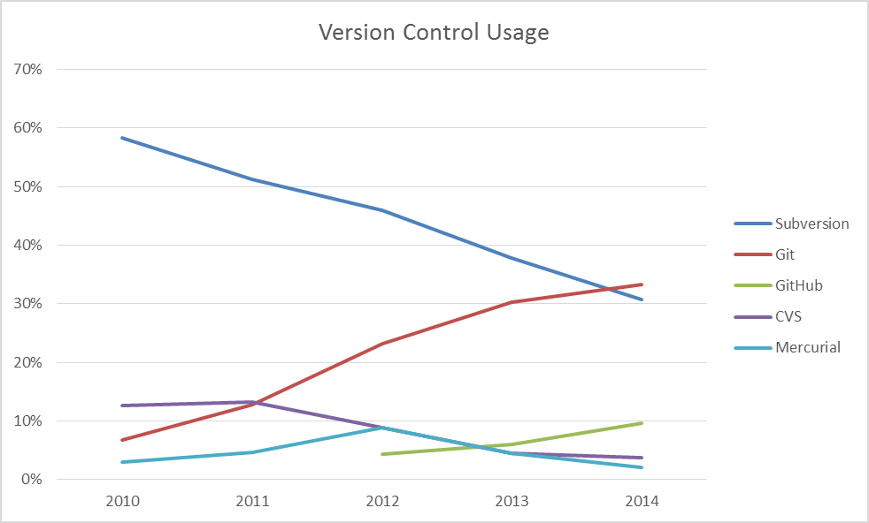
1. Introdução
Uso crescente de repositórios distribuídos
Fonte: Eclipse Foundation. The Open Source Developer Report - 2014 Eclipse Community Survey.

Slide 5
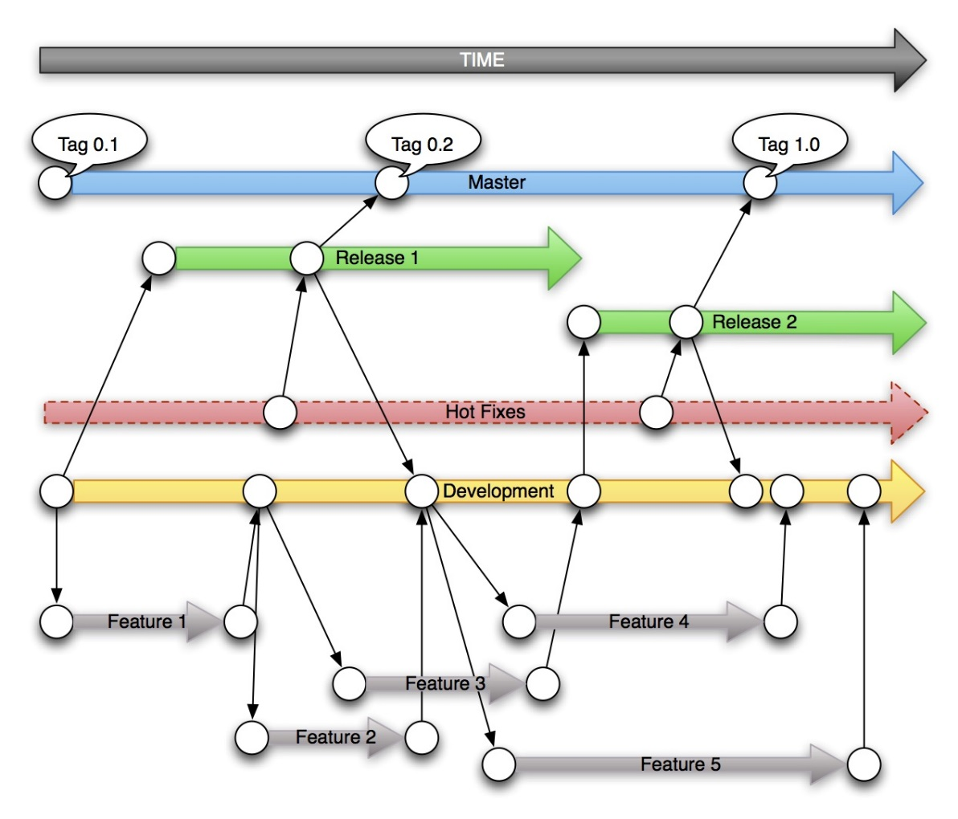
1. Introdução
Uso crescente de repositórios distribuídos
Proliferação de ramos
Notes:
Proliferação de ramos

Slide 6
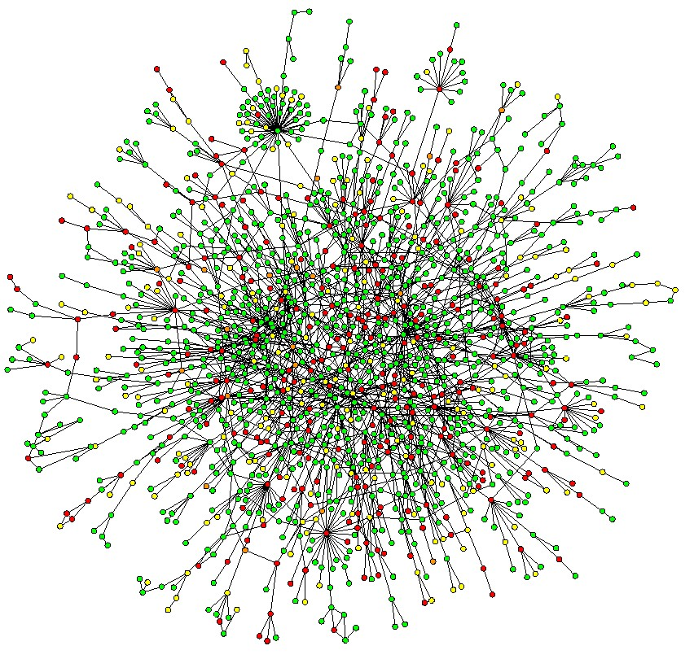
1. Introdução
Uso crescente de repositórios distribuídos
Proliferação de ramos
Notes:
Proliferação de ramos

Slide 7
1. Introdução
Ramificação em Sistemas de Controle de Versão Centralizados (SCVC)
master
1
2
3
Notes:
Physical distance
Time zone disparity
Domain expertise
Architecture
Software integration
Software conf. mngt.
Vendor support
Governmental issues
Development process
Local impression of remote terms

Slide 8
1. Introdução
Ramificação em Sistemas de Controle de Versão Centralizados (SCVC)
master
1
2
3
issue55
Notes:
Physical distance
Time zone disparity
Domain expertise
Architecture
Software integration
Software conf. mngt.
Vendor support
Governmental issues
Development process
Local impression of remote terms

Slide 9
1. Introdução
Ramificação em Sistemas de Controle de Versão Centralizados (SCVC)
master
1
2
3
4
6
5
7
issue55
Notes:
Physical distance
Time zone disparity
Domain expertise
Architecture
Software integration
Software conf. mngt.
Vendor support
Governmental issues
Development process
Local impression of remote terms

Slide 10
1. Introdução
Ramificação em Sistemas de Controle de Versão Centralizados (SCVC)
master
1
2
3
4
6
8
5
7
issue55
Notes:
Physical distance
Time zone disparity
Domain expertise
Architecture
Software integration
Software conf. mngt.
Vendor support
Governmental issues
Development process
Local impression of remote terms

Slide 11
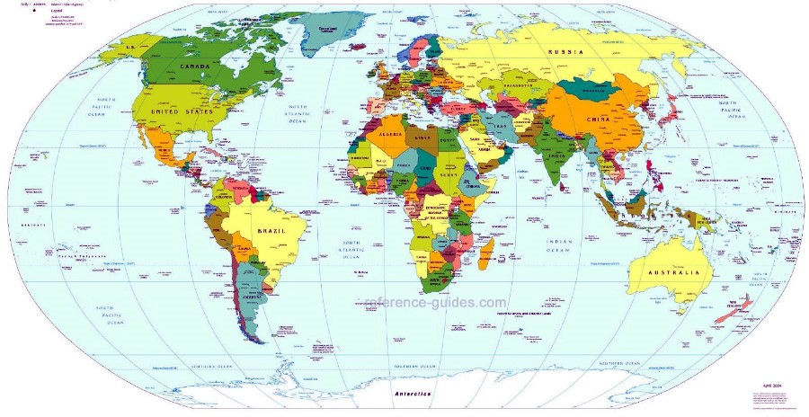
1. Introdução
Globalização
Desenvolvimento de Software também é distribuído
Fatores de risco[Battin et al. 2001]
Notes:
Risk Factors:
Physical distance
Time zone disparity
Domain expertise
Architecture
Software integration
Software conf. mngt.
Vendor support
Governmental issues
Development process
Local impression of remote terms

Slide 12


1. Introdução
Difícil colaboração e percepção de mudanças
?

Slide 13
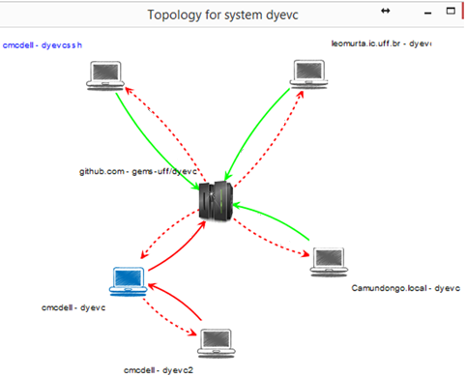

Slide 14
Motivation
Original repository
Clones
1
2
3
4’
5’
6’
Clone A
1
2
3
1
2
3
4’’
Clone B
1
2
3
4’’’
5’’’
6’’’
7’’’
Clone C
Notes:
Physical distance
Time zone disparity
Domain expertise
Architecture
Software integration
Software conf. mngt.
Vendor support
Governmental issues
Development process
Local impression of remote terms

Slide 15
Motivation
Original repository
Clones
1
2
3
4’’
Clone B
1
2
3
4’
5’
6’
1
2
3
4’’’
5’’’
6’’’
7’’’
Clone C
Original repository
Clones
1
2
3
4’’
5’’
Clone B
1
2
3
4’
5’
6’
4’
5’
6’
1
2
3
4’’’
5’’’
6’’’
7’’’
Clone C
Notes:
Physical distance
Time zone disparity
Domain expertise
Architecture
Software integration
Software conf. mngt.
Vendor support
Governmental issues
Development process
Local impression of remote terms

Slide 16
Motivation
Original repository
Clones
1
2
3
4’’
5’’
1
2
3
4’’’
5’’’
6’’’
7’’’
Clone C
4’
5’
6’
Original repository
Clones
1
2
3
4’’
5’’
1
2
3
4’’’
5’’’
6’’’
7’’’
8’’’
Clone C
4’
5’
6’
4’’
5’’
4’
5’
6’
Notes:
Physical distance
Time zone disparity
Domain expertise
Architecture
Software integration
Software conf. mngt.
Vendor support
Governmental issues
Development process
Local impression of remote terms

Slide 17
Motivation
Original repository
Clone B
master
master
1
2
3
4’
5’
6’
1
2
3
4’’
4’
5’
6’
origin/master
Original repository
master
Clone B
master
1
2
3
4’’
5’’
1
2
3
4’’
5’’
4’
5’
6’
4’
5’
6’
origin/master
Notes:
Physical distance
Time zone disparity
Domain expertise
Architecture
Software integration
Software conf. mngt.
Vendor support
Governmental issues
Development process
Local impression of remote terms

Slide 18
Motivation
master
1
2
3
4
5
Notes:
Physical distance
Time zone disparity
Domain expertise
Architecture
Software integration
Software conf. mngt.
Vendor support
Governmental issues
Development process
Local impression of remote terms

Slide 19



Motivation
Xavier Institute
Wolverine
Gambit
Professor Xavier
Rogue
Nightcrawler
Cyclops
Jean Gray
Mystique
Beast

Slide 20
Motivation
Xavier Institute
Wolverine
Storm
Gambit
Professor Xavier
Rogue
Nightcrawler
Cyclops
Jean Gray
Mystique
Push
Beast
Pull

Slide 21
Questions
Developer
How can I know at a given moment if there are commits that were not pulled yet?
Are there any local commits pending to be pushed?
Administrator
What are the existing clones of a system?
Who and how do they relate with?
How can I know if there are pending commits to be sent from a test repository to a production one?

Slide 22
Related Work
Awareness Tools
Conflict Avoidance
Conflict Detecting
Visualization
Repository Linearization

Slide 23
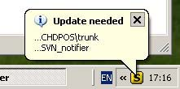
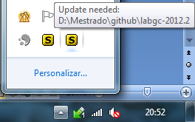
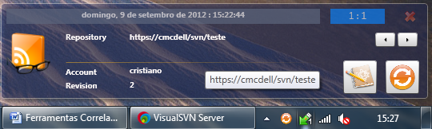
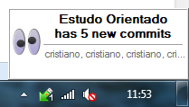
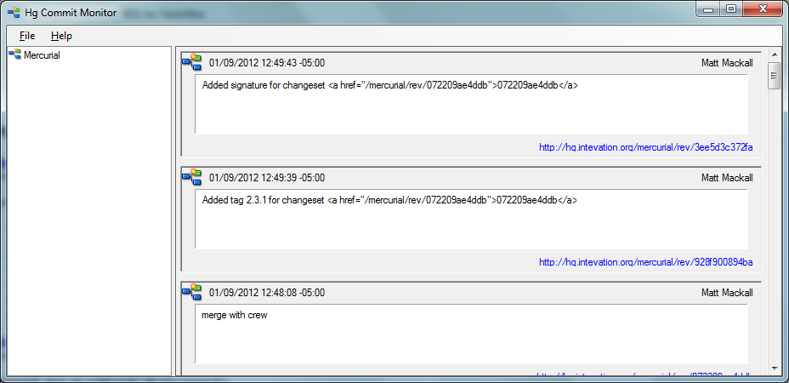
Related Work
SVN Notifier
Elvin
SCM Notifier
SVN Radar
Commit Monitor

Slide 24
Related Work
SVN Notifier
SCM Notifier
Commit Monitor
Elvin

Slide 25

Related Work - Awareness Tools
Conflict avoidance
Report new commits
Do not identify related repositories
Do not present information in different levels
SVN Notifier¹, SCM Notifier², Commit Monitor³, SVN Radar⁴ and Hg Commit Monitor⁵
¹http://svnnotifier.tigris.org/ (2012)
²https://github.com/pocorall/scm-notifier (2012)
³http://tools.tortoisesvn.net/CommitMonitor.html (2013)
⁴http://code.google.com/p/svnradar/ (2011)
⁵http://www.fsmpi.uni-bayreuth.de/~dun3/hg-commit-monitor (2009)

Slide 26

Related Work - Awareness Tools
Conflict detecting
CollabVS [Dewan and Hegde 2007], Crystal [Brun et al. 2011], FASTDash [Biehl et al.], Lighthouse [Da Silva et al. 2006], Palantir [Sarma and Van der Hoek 2002], Polvo [Santos and Murta 2012], WeCode [Guimarães and Silva 2012], Safe-Commit [Wloka et al. 2009]
Identify existing or potential conflicts
Only one supports DVCSs
Do not support scenarios with multiple partners

Slide 27
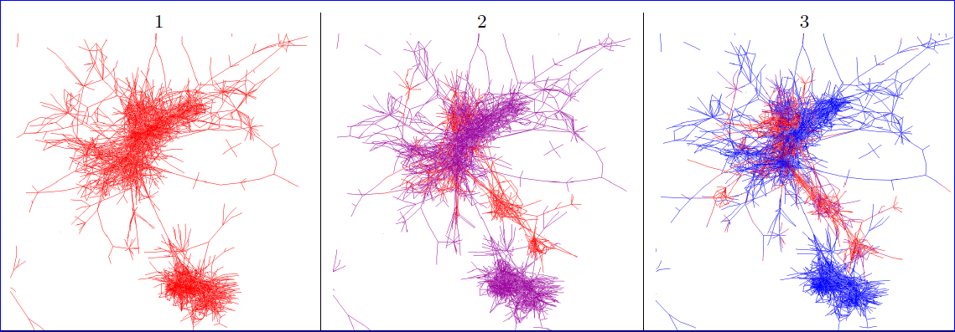
Related Work - Repository Linearization
Gevol [Collberg et al 2003]: Focus on program structure

Slide 28
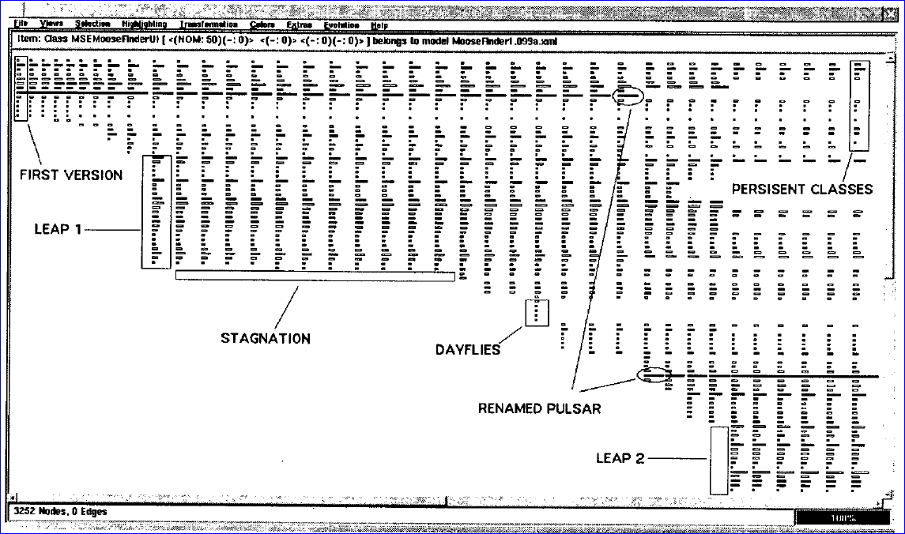
Related Work - Repository Linearization
The Evolution Matrix [Lanza 2001]: Focus on classes

Slide 29
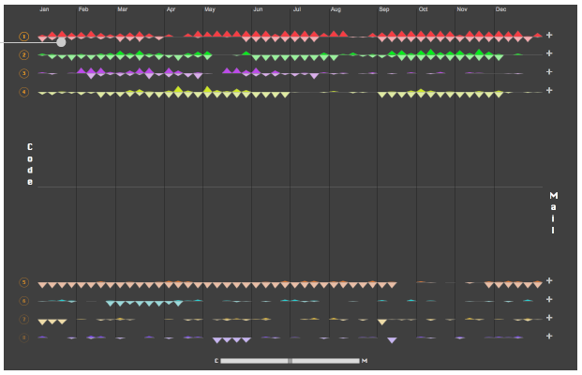
Related Work - Repository Linearization
LifeSource[Gilbert and Karahalios 2006]: Focus on Authors

Slide 30
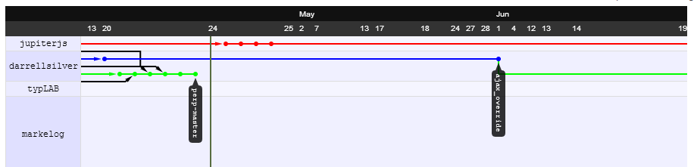
Related Work - Repository Linearization
VisGi [Elsen 2013]: Focus on Branches
GitHub’s Network Graph: Focus on Branches

Slide 31
Related Work
Most of the linearization tools work with CVCS’s
A few exceptions…
… which do not show where a given commit can be found
… which cannot be easily extended
No tools found for topology visualization

Slide 32

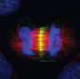
DyeVC*
DyeVC Database
rep
rep
rep
rep’
rep’
rep’
DyeVC App
DyeVC App
DyeVC App
*Dye over Version Control

Slide 33


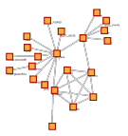

Technology Used
Java Web Start
Jgit Library
JUNG* Framework
MongoDB
*Java Universal Network/Graph Framework
Notes:
JUNG: Java Universal Network/Graph Framework

Slide 34





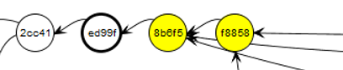
Different Visualization Levels
Level 1: Repositories
Level 2: Branches
Level 3: Commits

Slide 35
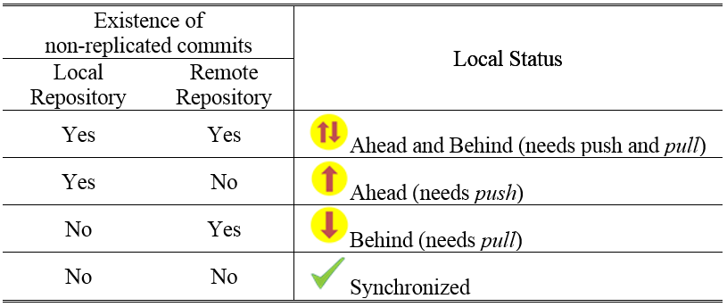
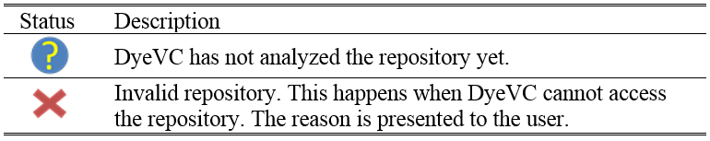
Possible state for a repository

Slide 36
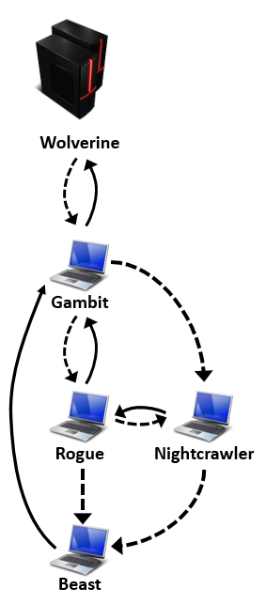
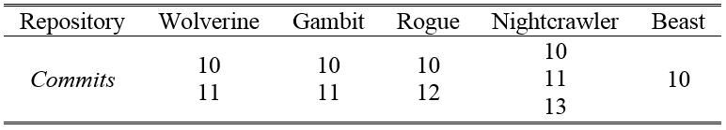
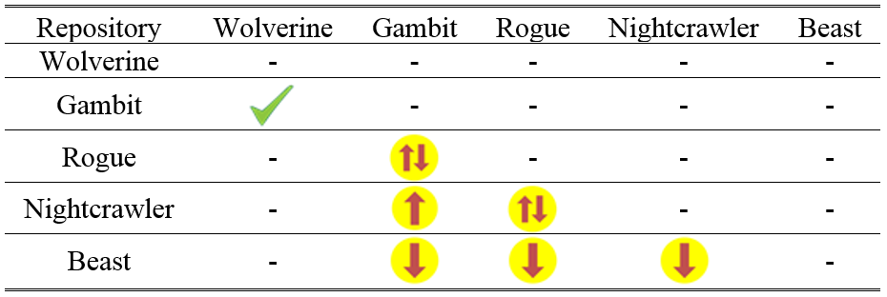
Example

Slide 37
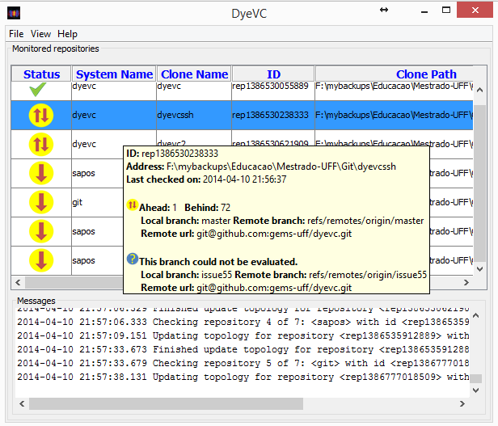
DyeVC - Main Screen

Slide 38
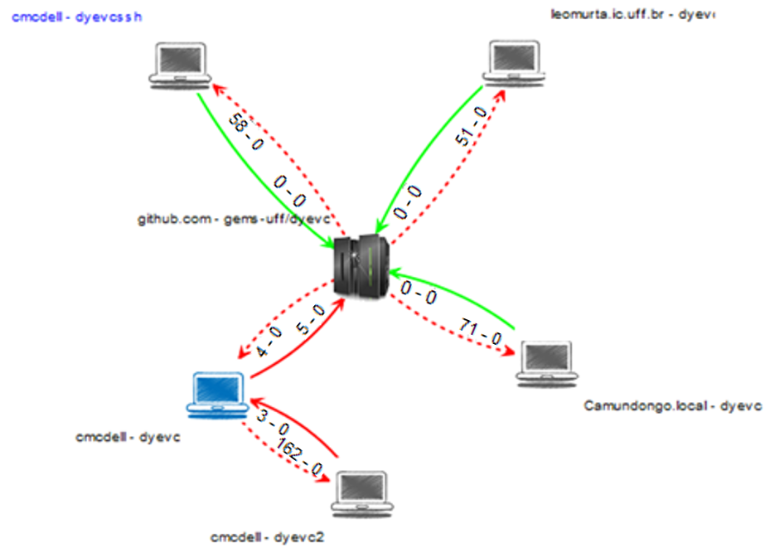
Visão de Topologia
Parceiro
Repositório central
Meu repositório

Slide 39
Visão de Topologia
Push, sincronizado
Push, não sincronizado
Pull, sincronizado
Pull, não sincronizado
Commits em ramos não rastreados
Commits em ramos rastreados

Slide 40
3
2
4
8
1
5
7
6

Slide 41
3
2
4
8
1
5
7
6

Slide 42
3
2
4
8
1
5
7
6

Slide 43
3
2
4
8
1
5
7
6

Slide 44
3
2
4
8
1
5
7
6

Slide 45
Posição dos Nós
1
2
3
5
6
8
4
7
Predecessor
1
2
3
5
6
8
4
7
Sucessores
1
2
3
5
6
8
4
7

Slide 46
0
S
M
A
-20
-40
-60
B
-80
-100
C

Slide 47
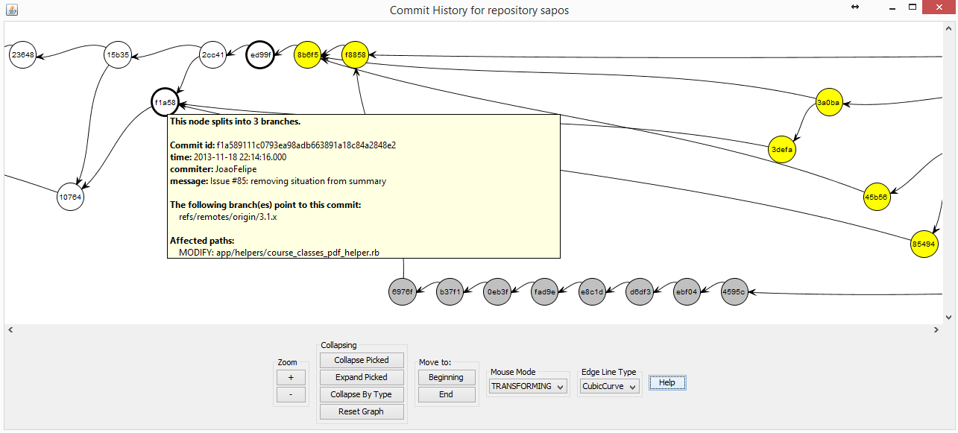
Commit History

Slide 48
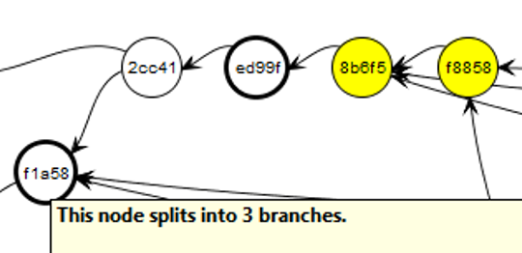
Commit History

Slide 49
História de Commits - Códigos de Cores
Onde o commit existe
Ramos e tags
fffff
Todos possuem
fffff
Commit regular
fffff
Não foi feito push para todos os parceiros
fffff
Apontado por um ramo
fffff
fffff
Não foi feito pull
Apontado por uma tag
fffff
Existe em alguém que não é parceiro
fffff
Está em um ramo não rastreado

Slide 50
Sumário
Introdução
Trabalhos relacionados
Objetivo
DyeVC: visão geral
Avaliação
Conclusão

Slide 51
Evaluation
Quantitative evaluation performed
Main operations measured
Open source repositories
Jgit
DyeVC
Tortoise Git
Drupal
Expresso Livre
Git

Slide 52
Evaluation

Slide 53
Evaluation

Slide 54
Evaluation
Current limitation in commit history ≈ 7000

Slide 55
Evaluation

Slide 56
Sumário
Introdução
Trabalhos relacionados
Objetivo
DyeVC: visão geral
Avaliação
Conclusão

Slide 57
Conclusion
DyeVC is a non-obtrusive tool to visualize dependencies among DVCSs
Monitors repositories continuously
Extensible, allowing new plugins and layouts
Response time and scalability depends upon the desired information granularity and repository size

Slide 58
Future Work
Different plugins for commit history
Collapse commits with same level of accessibility
Filter by author, date, etc.
New layouts to display different metrics
A few already created within our group
Integration with other awareness tools
E.g. Polvo, Kraken

Slide 59
References
DyeVC homepage: http://gems.ic.uff.br/dyevc/
Source code: https://github.com/gems-uff/dyevc
User Manual: https://github.com/gems-uff/dyevc/wiki/User-Manual

Slide 60
Awareness Over Distributed Version Control Systems
Obrigado!
Cristiano Machado Cesário
Advisor: Prof. D.Sc. Leonardo Gresta Paulino Murta
DyeVC está disponível em http://gems.ic.uff.br/dyevc

